Slide 1
Clustering
Luis Tari

Slide 2
Motivation
One of the important goals in the post-genomic era is to discover the functions of genes.
High-throughput technologies allow us to speed up the process of finding the functions of genes.
But there are tens of thousands of genes involved in a microarray experiment.
Questions:
  How do we analyze the data?
  Which genes should we start exploring?

Slide 3
Why clustering?
Let’s look at the problem in a different angle
  The issue here is dealing with high-dimensional data
How do people deal with high-dimensional data?
  Start by finding interesting patterns associated with the data
  Clustering is one of the well-known techniques with successful applications on large domain for finding patterns
Some successes in applying clustering on microarray data
  Golub et. al (1999) uses clustering techniques to discover subclasses of AML and ALL from microarray data
  Eisen et. al (1998) uses clustering techniques that are able to group genes of similar function together.
But what is clustering?

Slide 4
Introduction
The goal of clustering is to
  group data points that are close (or similar) to each other
  identify such groupings (or clusters) in an unsupervised manner
    Unsupervised: no information is provided to the algorithm on which data points belong to which clusters
Example
What should the clusters be for these data points?
x
x
x
x
x
x
x
x
x

Slide 5
What can we do with clustering?
One of the major applications of clustering in bioinformatics is on microarray data to cluster similar genes
  Hypotheses:
    Genes with similar expression patterns implies that the coexpression of these genes
    Coexpressed genes can imply that
      they are involved in similar functions
      they are somehow related, for instance because their proteins directly/indirectly interact with each other
    It is widely believed that coexpressed genes implies that they are involved in similar functions
But still, what can we really gain from doing clustering?
Notes:
It is important to keep in mind that clustering is not only for microarray data, but can be used on other high-throughput data such as protein-protein interactions, CGH, phylogenetic profiles.
But what we seek from clustering other kinds of data can be different.

Slide 6
Purpose of clustering on microarray data
Suppose genes A and B are grouped in the same cluster, then we hypothesis that genes A and B are involved in similar function.
  If we know the role of gene A is apoptosis
  but we do not know if gene B is involved in apoptosis
  we can do experiments to confirm if gene B indeed is involved in apoptosis.

Slide 7
Purpose of clustering on microarray data
Suppose genes A and B are grouped in the same cluster, then we hypothesize that proteins A and B might interact with each other.
  So we can do experiments to confirm if such interaction exists.
So clustering microarray data in a way helps us make hypotheses about:
  potential functions of genes
  potential protein-protein interactions

Slide 8
Does clustering always work?
Do coexpressed genes always imply that they have similar functions?
Not necessarily
  housekeeping genes
    genes which always expressed or never expressed despite of different conditions
  there can be noise in microarray data
But clustering is useful in:
  visualization of data
  hypothesis generation

Slide 9
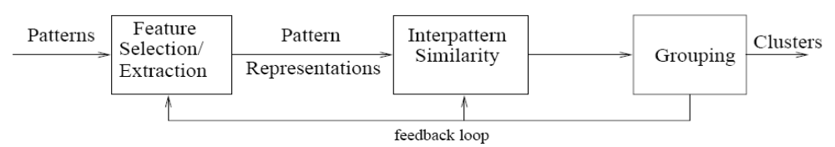
Overview of clustering
From the paper “Data clustering: review”
Feature Selection
  identifying the most effective subset of the original features to use in clustering
Feature Extraction
  transformations of the input features to produce new salient features.
Interpattern Similarity
  measured by a distance function defined on pairs of patterns.
Grouping
  methods to group similar patterns in the same cluster
Notes:
Features wrt microarray data can be genes
We will not talk about feature selection/extraction

Slide 10
Outline of discussion
Various clustering algorithms
  hierarchical
  k-means
  k-medoid
  fuzzy c-means
Different ways of measuring similarity
Measure validity of clusters
  How can we tell the generated clusters are good?
  How can we judge if the clusters are biologically meaningful?

Slide 11
Hierarchical clustering
Modified from Dr. Seungchan Kim’s slides
Given the input set S, the goal is to produce a hierarchy (dendrogram) in which nodes represent subsets of S.
Features of the tree obtained:
  The root is the whole input set S.
  The leaves are the individual elements of S.
  The internal nodes are defined as the union of their children.
Each level of the tree represents a partition of the input data into several (nested) clusters or groups.

Slide 12
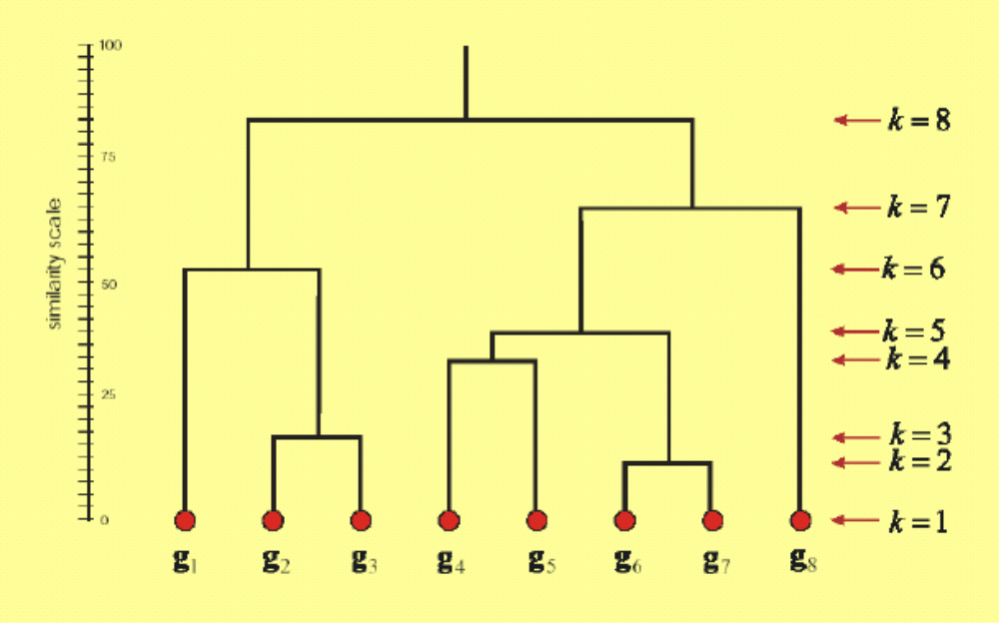
Hierarchical clustering

Slide 13
Hierarchical clustering
There are two styles of hierarchical clustering algorithms to build a tree from the input set S:
  Agglomerative (bottom-up):
    Beginning with singletons (sets with 1 element)
    Merging them until S is achieved as the root.
    It is the most common approach.
  Divisive (top-down):
    Recursively partitioning S until singleton sets are reached.

Slide 14
Hierarchical clustering
Input: a pairwise matrix involved all instances in S
Algorithm
  Place each instance of S in its own cluster (singleton), creating the list of clusters L (initially, the leaves of T):
    L= S₁, S₂, S₃, ..., S_{n-1}, S_{n}.
  Compute a merging cost function between every pair of elements in L to find the two closest clusters {S_{i}, S_{j}} which will be the cheapest couple to merge.
  Remove S_{i} and S_{j} from L.
  Merge S_{i} and S_{j} to create a new internal node S_{ij} in T which will be the parent of S_{i} and S_{j} in the resulting tree.
  Go to Step 2 until there is only one set remaining.

Slide 15
Hierarchical clustering
Step 2 can be done in different ways, which is what distinguishes single-linkage from complete-linkage and average-linkage clustering.
  In single-linkage clustering (also called the connectedness or minimum method): we consider the distance between one cluster and another cluster to be equal to the shortest distance from any member of one cluster to any member of the other cluster.
  In complete-linkage clustering (also called the diameter or maximum method), we consider the distance between one cluster and another cluster to be equal to the greatest distance from any member of one cluster to any member of the other cluster.
  In average-linkage clustering, we consider the distance between one cluster and another cluster to be equal to the average distance from any member of one cluster to any member of the other cluster.

Slide 16
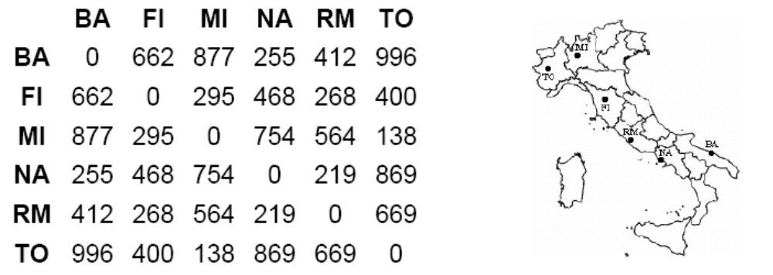
Hierarchical clustering: example

Slide 17
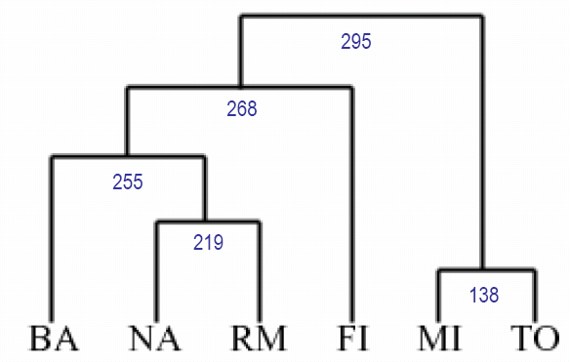
Hierarchical clustering: example using single linkage

Slide 18
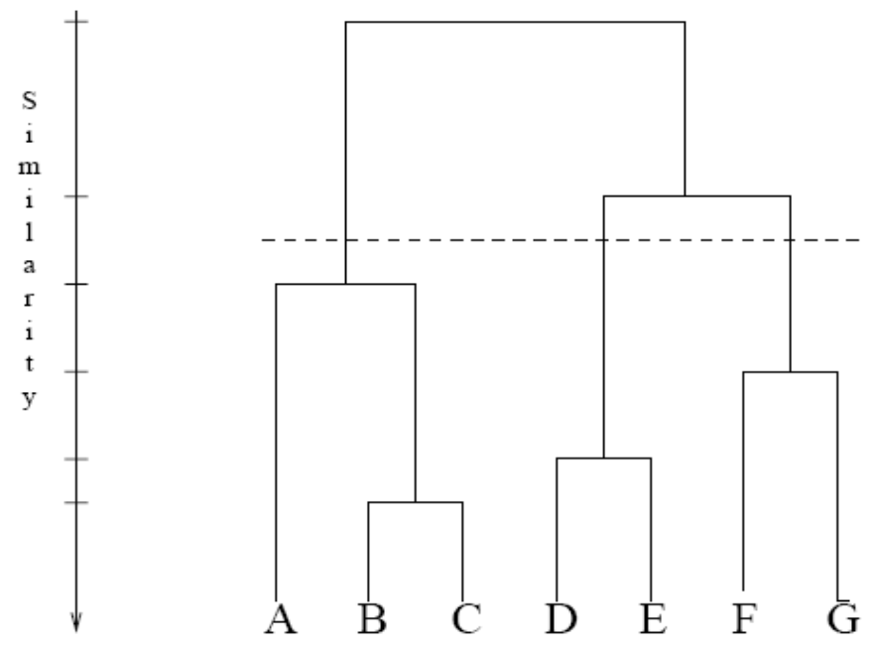
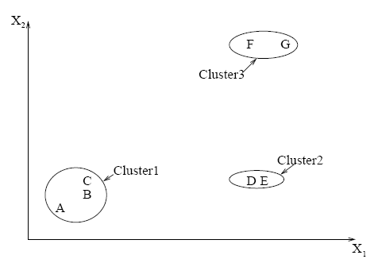
Hierarchical clustering: forming clusters
Forming clusters from dendograms

Slide 19
Hierarchical clustering
Advantages
  Dendograms are great for visualization
  Provides hierarchical relations between clusters
  Shown to be able to capture concentric clusters
Disadvantages
  Not easy to define levels for clusters
  Experiments showed that other clustering techniques outperform hierarchical clustering

Slide 20
K-means
Input: n objects (or points) and a number k
Algorithm
  Randomly place K points into the space represented by the objects that are being clustered. These points represent initial group centroids.
  Assign each object to the group that has the closest centroid.
  When all objects have been assigned, recalculate the positions of the K centroids.
  Repeat Steps 2 and 3 until the stopping criteria is met.

Slide 21
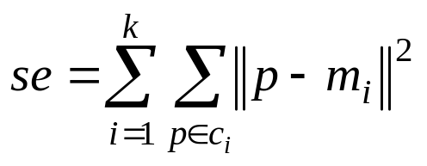
K-means
Stopping criteria:
  No change in the members of all clusters
  when the squared error is less than some small threshold value α
    Squared error se
      where m_{i} is the mean of all instances in cluster c_{i}
    se^{(j)} < α
Properties of k-means
  Guaranteed to converge
  Guaranteed to achieve local optimal, not necessarily global optimal.
Example: http://www.kdnuggets.com/dmcourse/data_mining_course/mod-13-clustering.ppt.

Slide 22
K-means
Pros:
  Low complexity
    complexity is O(nkt), where t = #iterations
Cons:
  Necessity of specifying k
  Sensitive to noise and outlier data points
    Outliers: a small number of such data can substantially influence the mean value)
  Clusters are sensitive to initial assignment of centroids
    K-means is not a deterministic algorithm
    Clusters can be inconsistent from one run to another
Notes:
Modified from Dr. Baral’s slides

Slide 23
Fuzzy c-means
An extension of k-means
Hierarchical, k-means generates partitions
  each data point can only be assigned in one cluster
Fuzzy c-means allows data points to be assigned into more than one cluster
  each data point has a degree of membership (or probability) of belonging to each cluster
Notes:
Compare degrees of memberships in k-means and fuzzy c-means

Slide 24
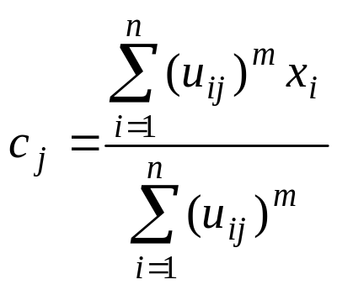
Fuzzy c-means algorithm
Let x_{i} be a vector of values for data point g_{i}.
Initialize membership U⁽⁰⁾ = [ u_{ij} ] for data point g_{i} of cluster cl_{j} by random
At the k-th step, compute the fuzzy centroid C^{(k)} = [ c_{j} ] for j = 1, .., nc, where nc is the number of clusters, using
  where m is the fuzzy parameter and n is the number of data points.

Slide 25
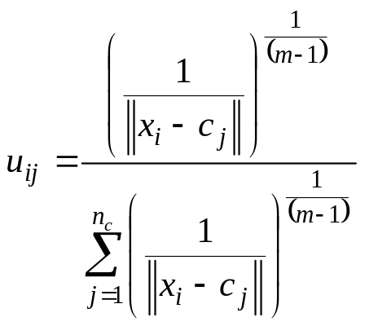
Fuzzy c-means algorithm
Update the fuzzy membership U^{(k)} = [ u_{ij} ], using
If ||U^{(k)} – U^{(k-1)}|| < ε, then STOP, else return to step 2.
Determine membership cutoff
  For each data point g_{i}, assign g_{i} to cluster cl_{j} if u_{ij} of U^{(k)} > α

Slide 26
Fuzzy c-means
Pros:
  Allows a data point to be in multiple clusters
  A more natural representation of the behavior of genes
    genes usually are involved in multiple functions
Cons:
  Need to define c, the number of clusters
  Need to determine membership cutoff value
  Clusters are sensitive to initial assignment of centroids
    Fuzzy c-means is not a deterministic algorithm

Slide 27
Similarity measures
How to determine similarity between data points
  using various distance metrics
Let x = (x₁,…,x_{n}) and y = (y₁,…y_{n}) be n-dimensional vectors of data points of objects g₁ and g₂
  g₁, g₂ can be two different genes in microarray data
  n can be the number of samples
Notes:
Material from “Data Analysis tools for DNA microarrays” by Sorin Draghici

Slide 28
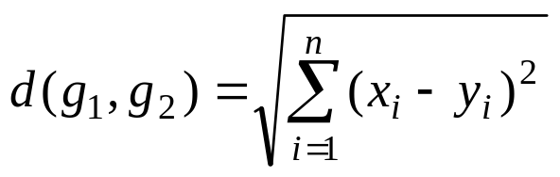
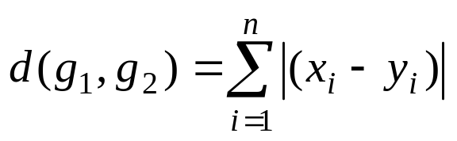
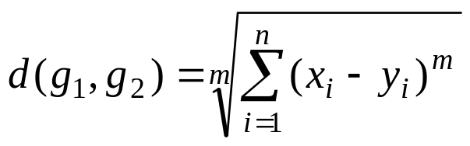
Distance measure
Euclidean distance
Manhattan distance
Minkowski distance

Slide 29
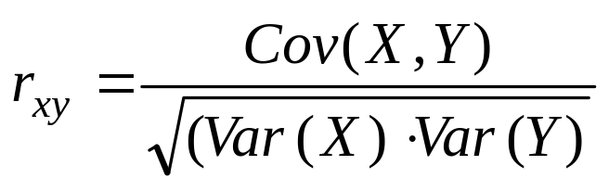
Correlation distance
Correlation distance
  Cov(X,Y) stands for covariance of X and Y
    degree to which two different variables are related
  Var(X) stands for variance of X
    measurement of a sample differ from their mean

Slide 30
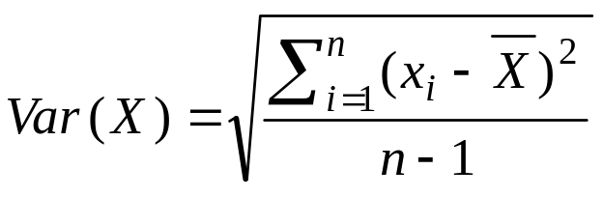
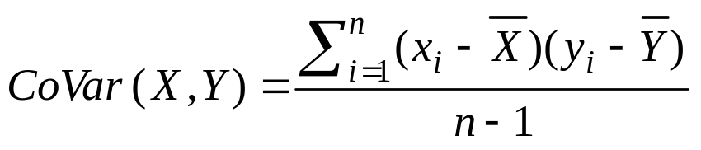
Correlation distance
Variance
Covariance
  Positive covariance
    two variables vary in the same way
  Negative covariance
    one variable might increase when the other decreases
  Covariance is only suitable for heterogeneous pairs

Slide 31
Correlation distance
Correlation
  maximum value of 1 if X and Y are perfectly correlated
  minimum value of 1 if X and Y are exactly opposite
  d(X,Y) = 1 - r_{xy}

Slide 32
Summary of similarity measures
Using different measures for clustering can yield different clusters
Euclidean distance and correlation distance are the most common choices of similarity measure for microarray data
Euclidean vs Correlation Example
  g1 = (1,2,3,4,5)
  g2 = (100,200,300,400,500)
  g3 = (5,4,3,2,1)
  Which genes are similar according to the two different measures?

Slide 33
Validity of clusters
Why validity of clusters?
  Given some data, any clustering algorithm generates clusters
  So we need to make sure the clustering results are valid and meaningful.
Measuring the validity of clustering results usually involve
  Optimality of clusters
  Verification of biological meaning of clusters
Notes:
Even when the data is generated randomly

Slide 34
Optimality of clusters
Optimal clusters should
  minimize distance within clusters (intracluster)
  maximize distance between clusters (intercluster)
Example of intracluster measure
    Squared error se
      where m_{i} is the mean of all instances in cluster c_{i}

Slide 35
Biological meaning of clusters
Manually verify the clusters using the literature
Can utilize the biological process ontology of the Gene Ontology to do the verification
  FD Gibbons and FP Roth. Judging the quality of gene expression-based clustering methods using gene annotation, Genome Research 12(10): 1574 - 1581 (2002).
  GoMiner: A Resource for Biological Interpretation of Genomic and Proteomic Data. Barry R. Zeeberg, Weimin Feng, Geoffrey Wang, May D. Wang, Anthony T. Fojo, Margot Sunshine, Sudarshan Narasimhan, David W. Kane, William C. Reinhold, Samir Lababidi, Kimberly J. Bussey, Joseph Riss, J. Carl Barrett, and John N. Weinstein. Genome Biology, 2003 4(4):R28

Slide 36
References
A. K. Jain and M. N. Murty and P. J. Flynn, Data clustering: a review, ACM Computing Surveys, 31:3, pp. 264 - 323, 1999.
T. R. Golub et. al, Molecular Classification of Cancer: Class Discovery and Class Prediction by Gene Expression Monitoring, Science, 286:5439, pp. 531 – 537, 1999.
Gasch,A.P. and Eisen,M.B. (2002) Exploring the conditional coregulation of yeast gene expression through fuzzy k-means clustering. Genome Biol., 3, 1–22.
M. Eisen et. al, Cluster Analysis and Display of Genome-Wide Expression Patterns. Proc Natl Acad Sci U S A 95, 14863-8, 1998.

